Slide 1
Halliday & Resnick’s
Fundamentals of Physics
Extended Edition Wiley
Jearl Walker
Chapter 23
Gauss’s Law

Slide 2
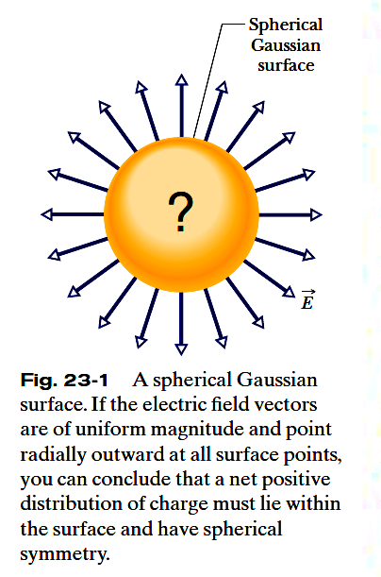
23.1 What is Physics?:
Gauss’ law relates the electric fields at points on a (closed) Gaussian surface to the net charge enclosed by that surface.
Gauss’ law considers a hypothetical (imaginary) closed surface enclosing the charge distribution.
This Gaussian surface, as it is called, can have any shape, but the shape that minimizes our calculations of
the electric field is one that mimics the symmetry of the charge distribution.

Slide 3
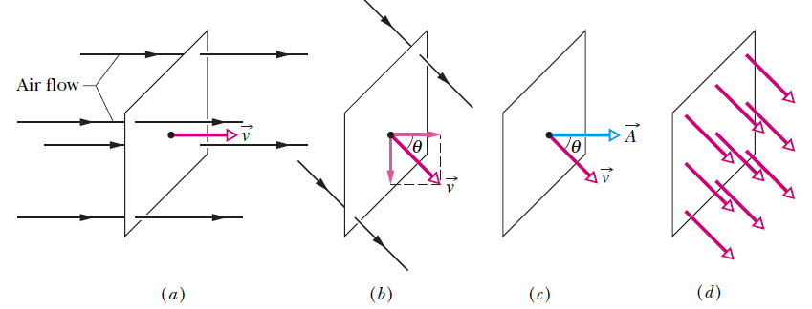

23.2: Flux
Fig. 23-2 (a) A uniform airstream of velocity is perpendicular to the plane of a square loop of area A.(b) The component of perpendicular to the plane of the loop is v cos θ,where θ is the angle between v
and a normal to the plane. (c) The area vector A is perpendicular to the plane of the loop and makes an angle θ with v. (d) The velocity field intercepted by the area of the loop. The rate of volume flow through the loop is Φ= (v cos θ)A.
This rate of flow through an area is an example of a flux—a volume flux in this situation.

Slide 4
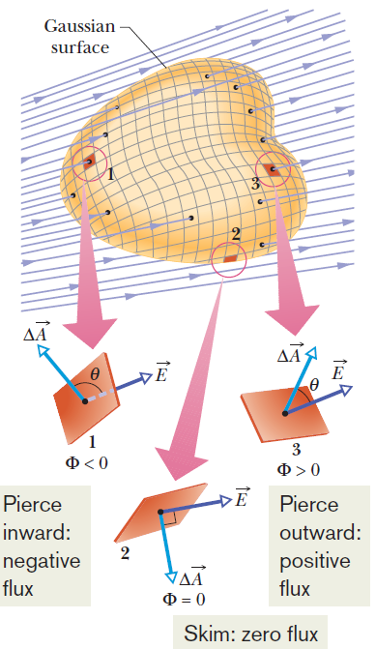

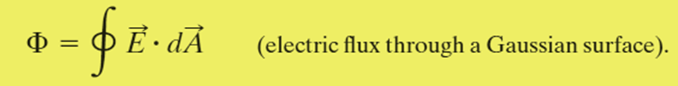
23.3: Electric Flux
The electric flux through a Gaussian surface is proportional to the net number of
electric field lines passing through that surface.
Fig. 23-3 A Gaussian surface of arbitrary shape immersed in an electric field. The surface is divided into
small squares of area ΔA. The electric field vectors E and the area vectors ΔA for three representative squares, marked 1, 2, and 3, are shown.
The exact definition of the flux of the electric field through a closed surface is found by allowing the area of the squares shown in Fig. 23-3 to become smaller
and smaller, approaching a differential limit dA. The area vectors then approach a differential limit dA.The sum of Eq. 23-3 then becomes an integral:

Slide 5
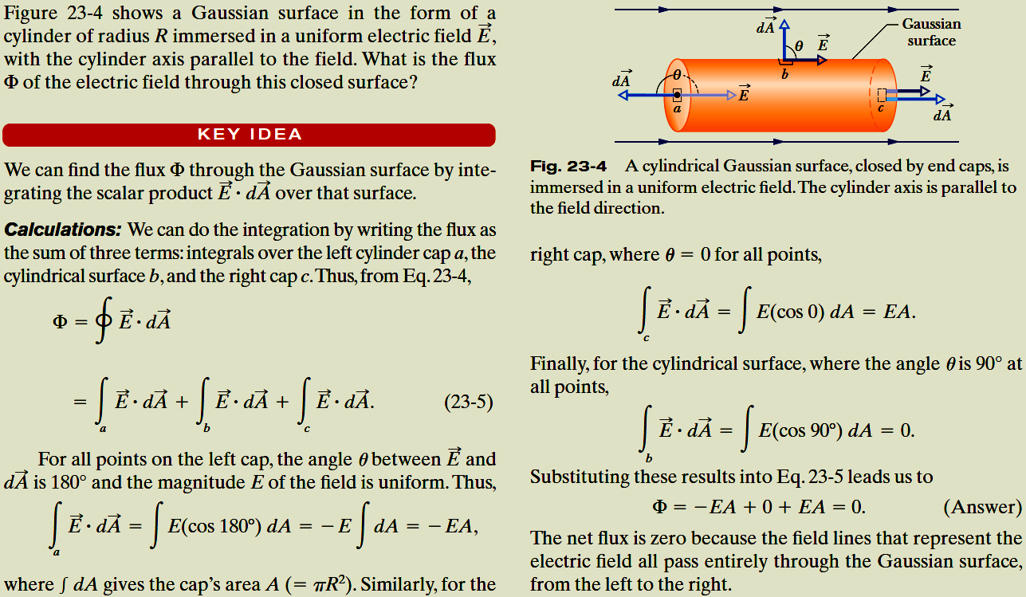
Example, Flux through a closed cylinder, uniform field:

Slide 6
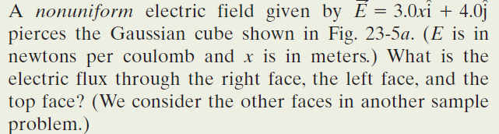
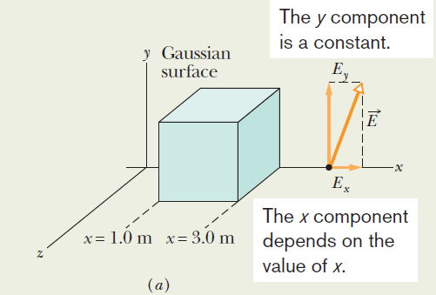

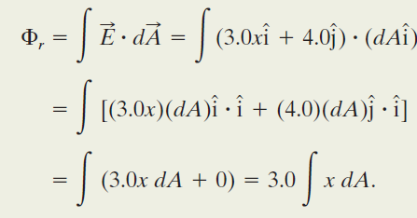


Example, Flux through a closed cube,
Non-uniform field:
Right face: An area vector A is always perpendicular to its surface and always points away from the interior of a Gaussian surface. Thus, the vector for any area element dA (small section) on the right face of the cube must point in the positive direction of the x axis. The most convenient way to express the vector is in unit-vector notation,
Although x is certainly a variable as we move left to right across the figure, because the right face is perpendicular to the x axis, every point on the face has the same x coordinate. (The y and z coordinates do not matter in our integral.) Thus, we have

Slide 7
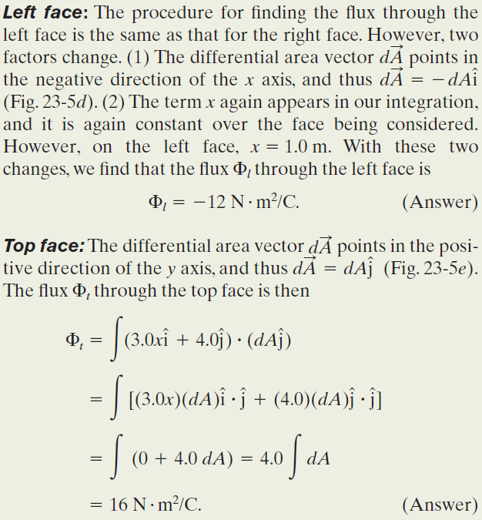
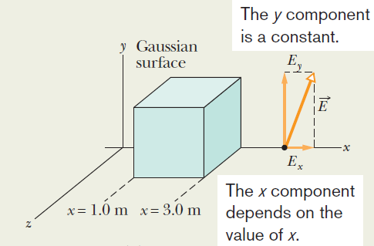
Example, Flux through a closed cube,
Non-uniform field:

Slide 8
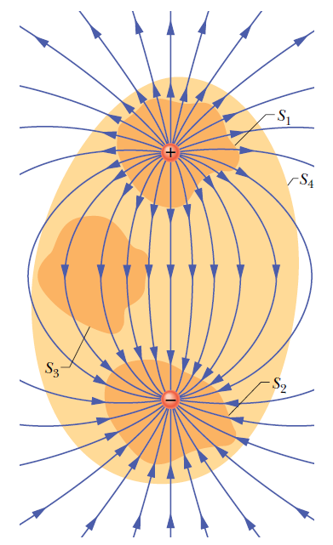


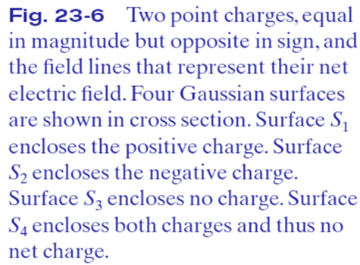
23.4 Gauss’s Law:
Gauss’ law relates the net flux of an electric field through a closed surface (a Gaussian surface) to the net charge q_{enc} that is enclosed by that surface.
The net charge q_{enc} is the algebraic sum of all the
enclosed positive and negative charges, and it can be positive, negative, or zero.
If q_{enc} is positive, the net flux is outward; if q_{enc} is negative, the net flux is inward.

Slide 9
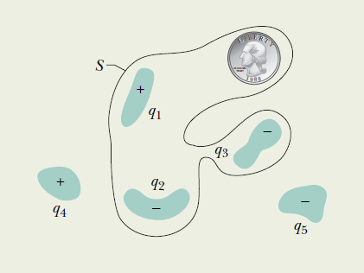
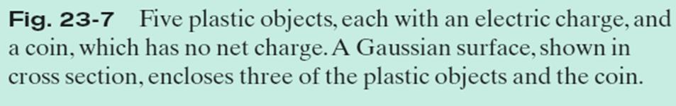
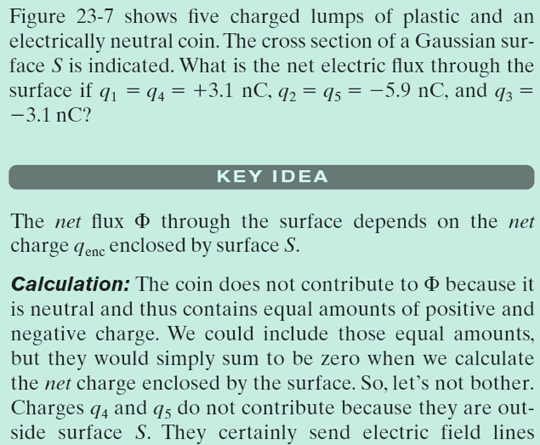
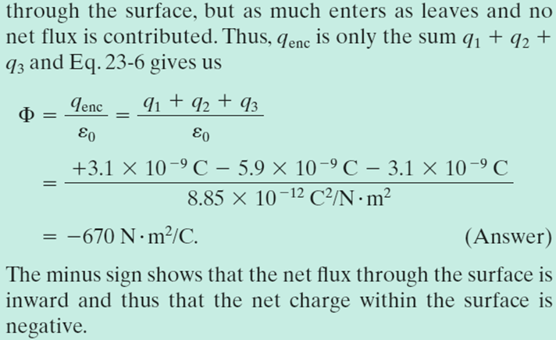
Example, Relating the net enclosed charge and the net flux:

Slide 10
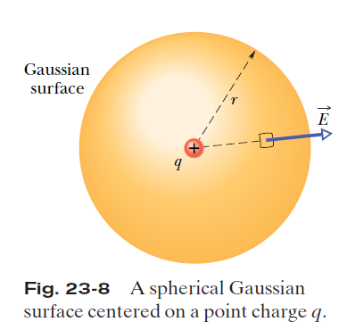


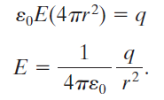
23.5 Gauss’s Law and Coulomb’s Law:
Figure 23-8 shows a positive point charge q, around which a concentric spherical Gaussian surface of radius r is drawn. Divide this surface into differential areas dA.
The area vector dA at any point is perpendicular
to the surface and directed outward from the interior.
From the symmetry of the situation, at any point the electric field, E, is also perpendicular to the surface and directed outward from the interior.
Thus, since the angle θ between E and dA is zero, we can rewrite Gauss’ law as
This is exactly what Coulomb’s law yielded.

Slide 11
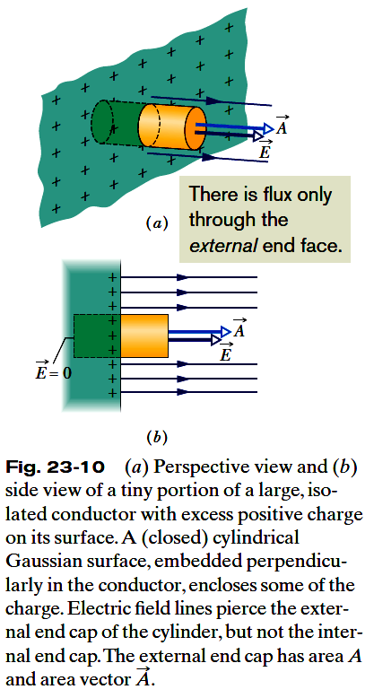
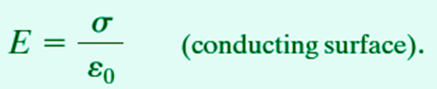

23.6 A Charged Isolated Conductor; The External Electric Field:
The electric field just outside the surface of a conductor is easy to
determine using Gauss’ law.
Consider a section of the surface that is small enough to neglect any curvature and thus the section is considered flat.
A tiny cylindrical Gaussian surface is embedded in the section as in Fig. 23-10: One end cap is fully inside the conductor, the other is
fully outside, and the cylinder is perpendicular to the conductor’s surface.
The electric field E at and just outside the conductor’s surface must also be perpendicular to that surface.
We assume that the cap area A is small enough that the field
magnitude E is constant over the cap.
Then the flux through the cap is EA, and that is the net flux Φ through the Gaussian surface.
The charge q_{enc} enclosed by the Gaussian surface lies on the conductor’s surface in an area A. If σ is the charge per unit area, then q_{enc} is equal to σA.

Slide 12
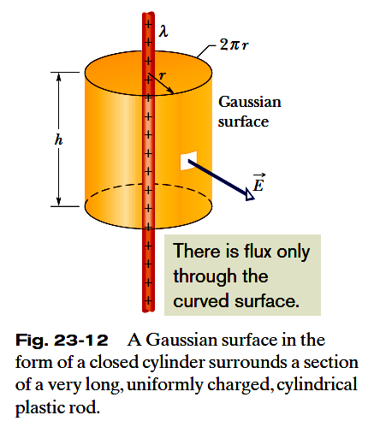
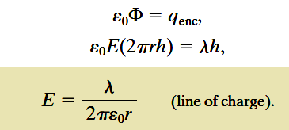
23.7 Applying Gauss’s Law and Cylindrical Symmetry:
Figure 23-12 shows a section of an infinitely long cylindrical plastic rod with a uniform positive linear charge density λ.
Let us find an expression for the magnitude of the electric field E at a distance r from the axis of the rod.
At every point on the cylindrical part of the Gaussian surface, must have the same magnitude E and (for a positively charged rod) must be directed radially outward.
The flux of E through this cylindrical surface is

Slide 13
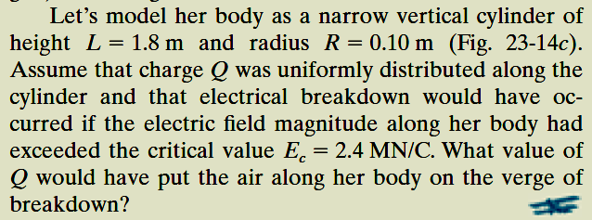
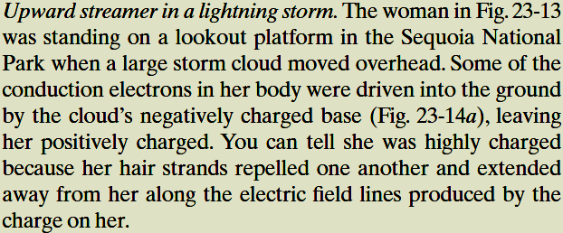
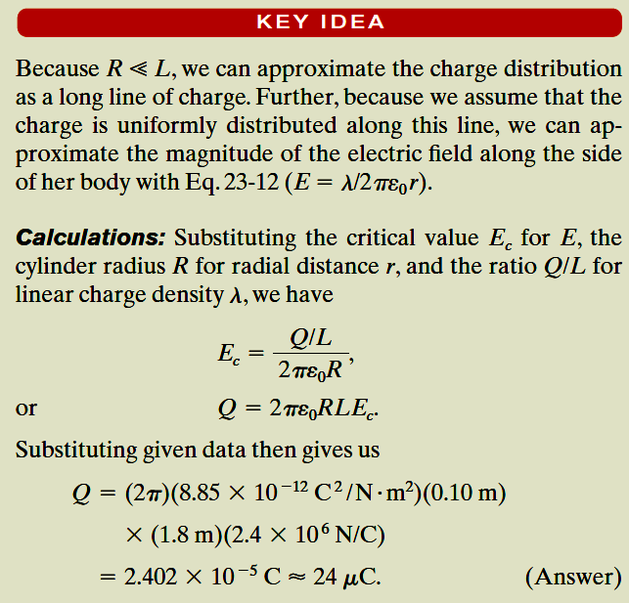
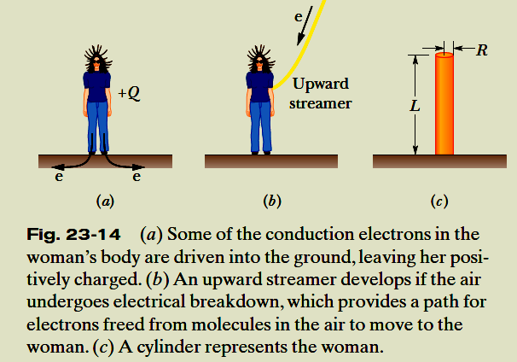
Example, Gauss’s Law and an
upward streamer in a lightning storm:

Slide 14
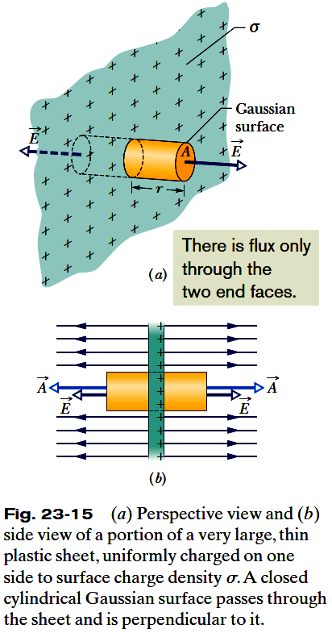
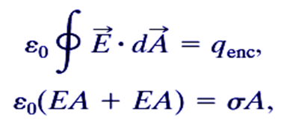

23.8 Applying Gauss’s Law, Planar Symmetry
Non-conducting Sheet:
Figure 23-15 shows a portion of a thin, infinite, nonconducting sheet with a uniform (positive) surface charge density σ.
A sheet of thin plastic wrap, uniformly charged on one side, can serve as a simple model.
We need to find the electric field a distance r in front of the sheet.
A useful Gaussian surface is a closed cylinder with end caps of area A, arranged to pierce the sheet perpendicularly as shown.
From symmetry, E must be perpendicular to the sheet and hence to the end caps.
Since the charge is positive, E is directed away from the sheet.
There is no flux through this portion of the Gaussian surface. Thus E.dA is simply EdA, and
Here σA is the charge enclosed by the Gaussian surface.
Therefore,

Slide 15
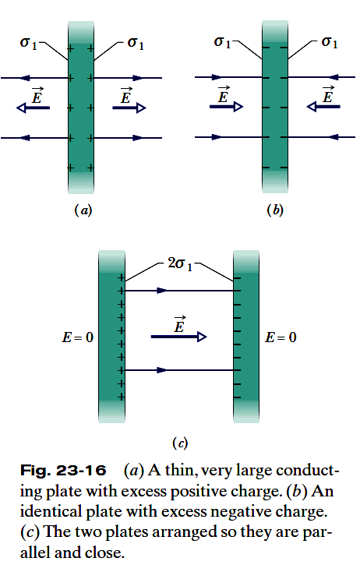
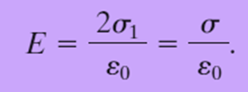
23.8 Applying Gauss’s Law, Planar Symmetry
Two Conducting Plates:
Figure 23-16a shows a cross section of a thin, infinite conducting plate with excess positive charge. The plate is thin and very large, and essentially all the excess charge is on the two large faces of the plate.
If there is no external electric field to force the positive charge into some particular distribution, it will spread out on the two faces with a uniform surface charge density of magnitude σ₁.
Just outside the plate this charge sets up an electric field of magnitude
E =σ₁/ε₀.
Figure 23-16b shows an identical plate with excess negative charge having the same magnitude of surface charge density. Now the electric field is directed toward the plate. E =σ₁/ε₀.
If we arrange for the plates of Figs. 23-16 a and b to be close to each other and parallel (Fig. 23-16c), the excess charge on one plate attracts the excess charge on the other plate, and all the excess charge moves onto the inner faces of the plates as in Fig. 23-16c.
With twice as much charge now on each inner face, the new surface charge density, σ, on each inner face is twice σ₁.
Thus, the electric field at any point between the plates has the magnitude

Slide 16
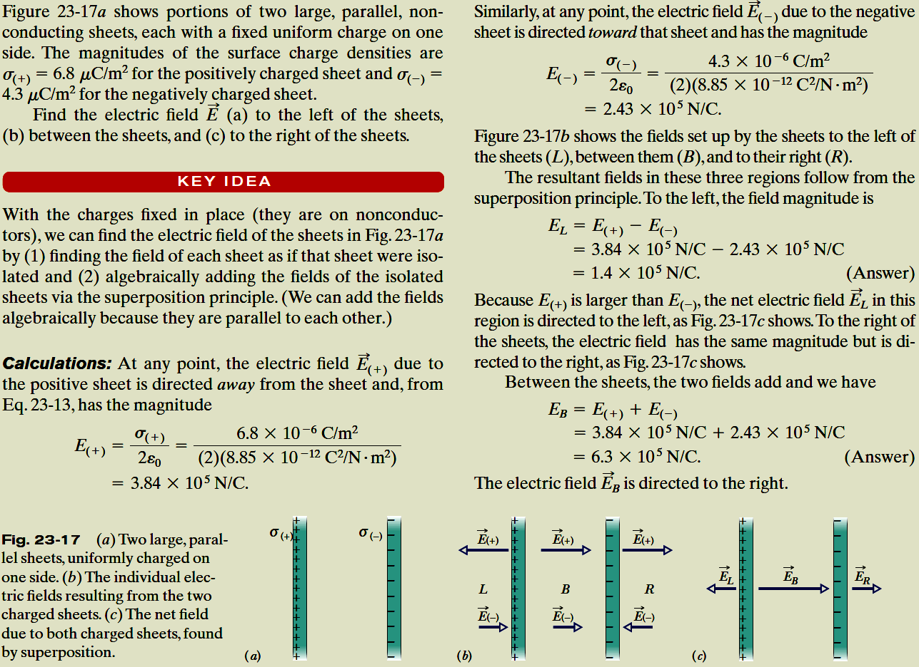
Example, Electric Field:

Slide 17
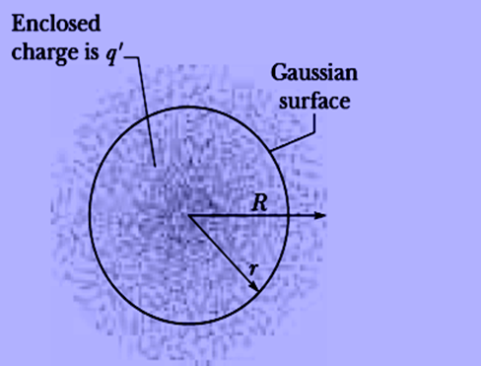
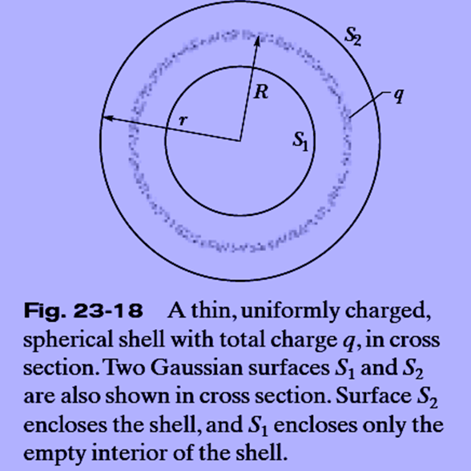




23.9 Applying Gauss’s Law, Spherical Symmetry:
A shell of uniform charge attracts or repels a charged particle that is outside the shell as if all the shell’s charge were concentrated at the center of the shell.
If a charged particle is located inside a shell of uniform charge, there is no electrostatic force on the particle from the shell.
Fig. 23-19 The dots represent a spherically symmetric distribution of charge of radius R, whose volume charge density ρ is a function only of distance from the center. The charged object is not a conductor, and therefore the charge is assumed to be fixed in position. A concentric spherical Gaussian surface with r >R is shown.

